Slide 1

High Temperature Structures Tropical Forest Drosophila Communities
Jinlin Chen
(jinlin.chen@zoo.ox.ac.uk)
University of Oxford
Student Talk

Slide 2
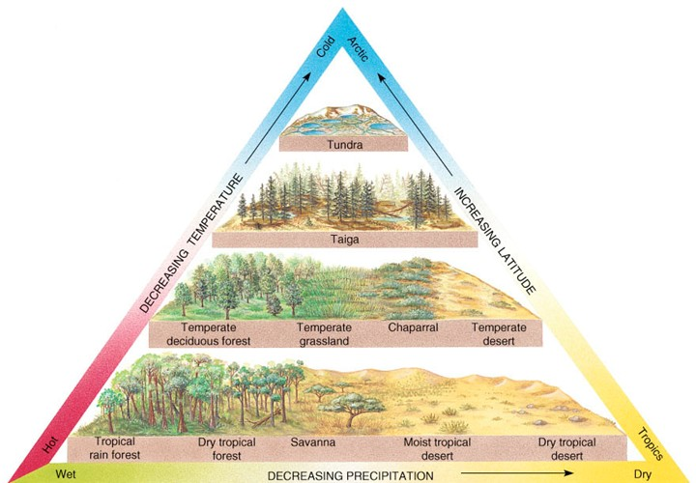
Species turnover along an environmental gradient is a widespread phenomenon
credit: Wikipedia

Slide 3
Mapping thermal performance on the temperature gradient
Thermal performance
Species A
Temperate systems
Species B
Cold
Warm

Slide 4
Mapping thermal performance on the temperature gradient
Thermal performance
Which part of the thermal performance curve drives species distribution in tropics
?
Species C
Species D
Cold
Warm

Slide 5


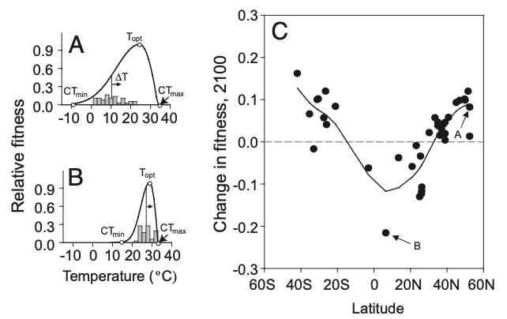

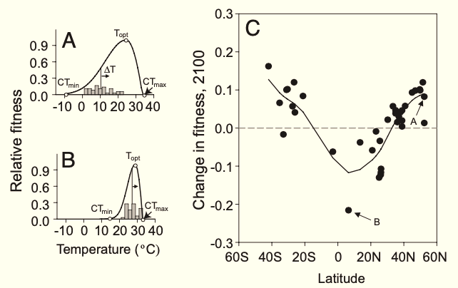
Controversy over the sensitivity of tropical species to global warming
?
Tropical species have smaller thermal safety margins.
Heat may not be the limiting factor of distribution at warmer boundaries.
Temperate
Tropic
Picture credit: Ke Hou
Deutsch, C. A., et al. PNAS, 105(18), 6668-6672.

Slide 6
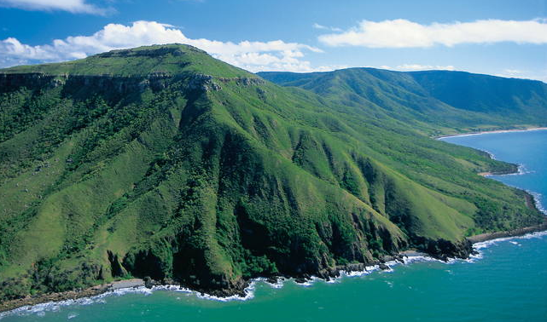
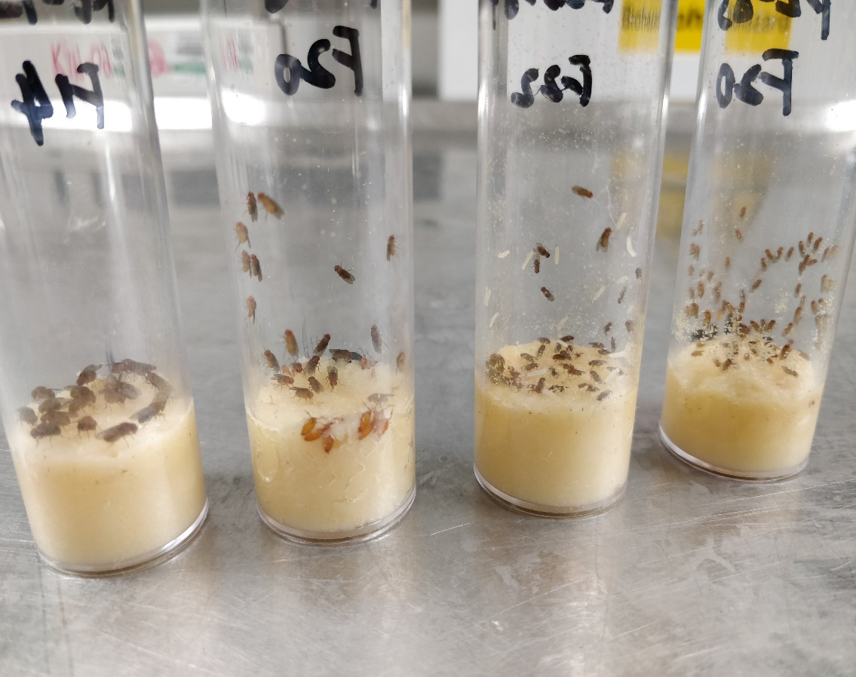
More case studies are needed to reveal the role of temperature in structuring species distribution in tropics.
Australian Wet Tropics
Drosophila species
Photo credit: UNESCO

Slide 7
Research Questions
Is community composition sensitive to elevation change?
Are there variations of thermal traits?
How does thermal tolerance correlate with distribution on tropical mountains?
What is the relative role of temperature and competition in distribution?
(in our studied system)

Slide 8

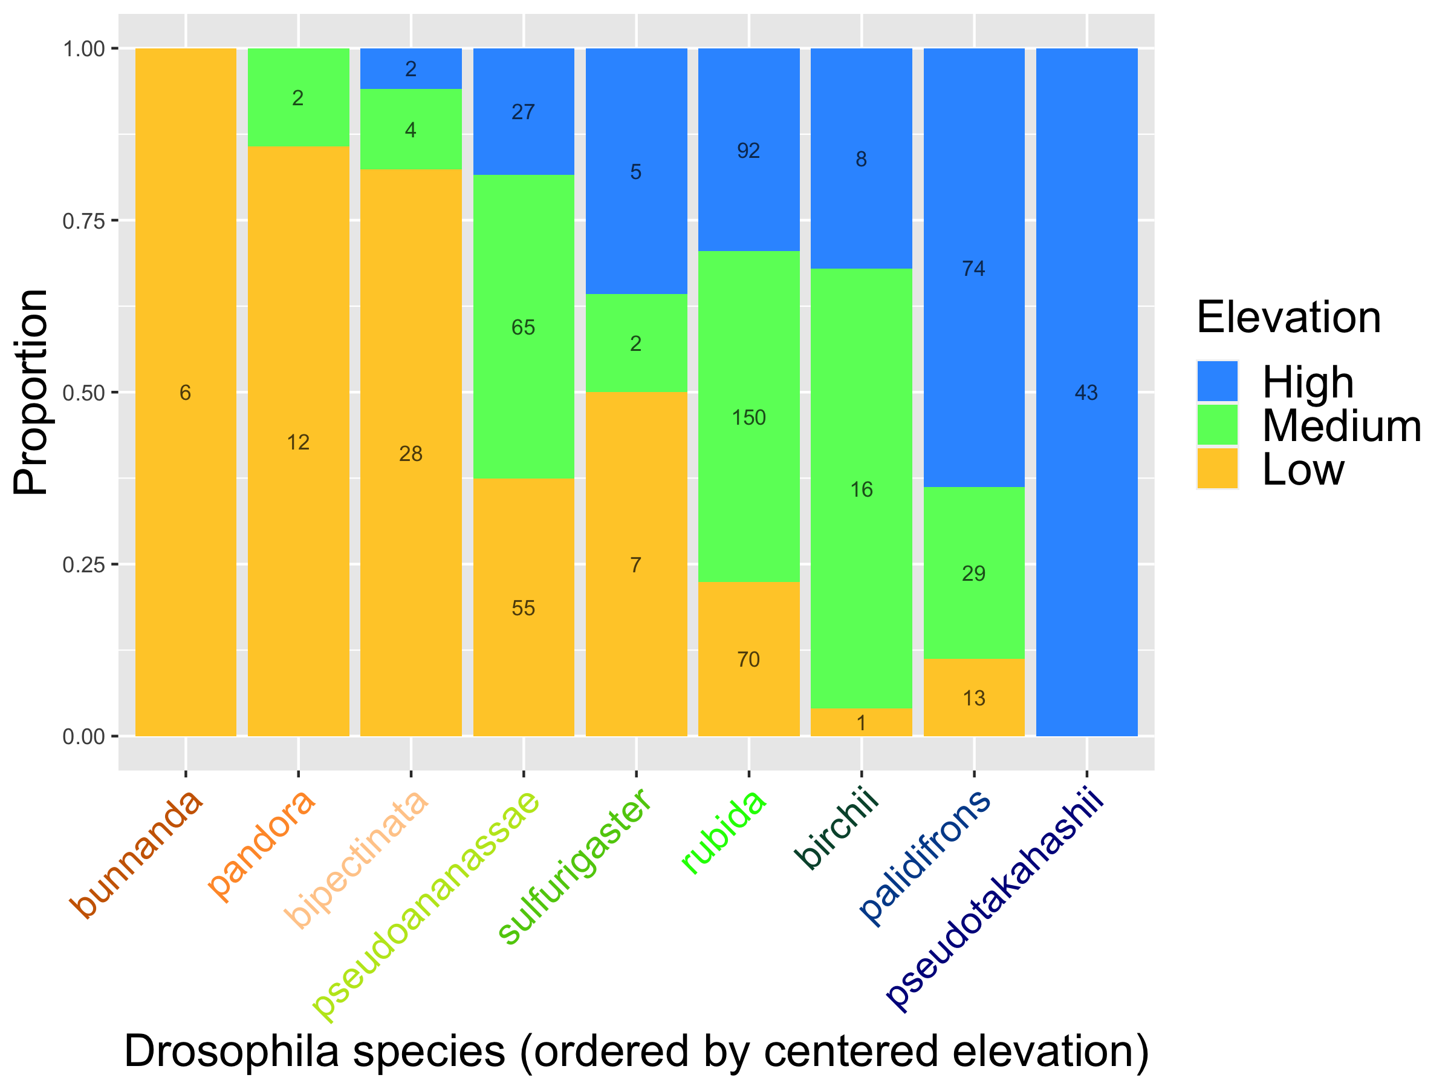
Species turnover along the elevational gradient
(# of samples)
Distribution categories by logistic regression of occurrence.
Consistent between both indicators: Spearman’s rank rho = 0.98, p < 0.0001.
Notes:
[Is there potential problem that it is all relative abundance here. For example, the abosolute abundance of pan increase with altitude, but more other species are found there, so the proportion of pan is low, then if you sample 200, the number of pan sample is lower than the number sampled in lowland.]

Slide 9
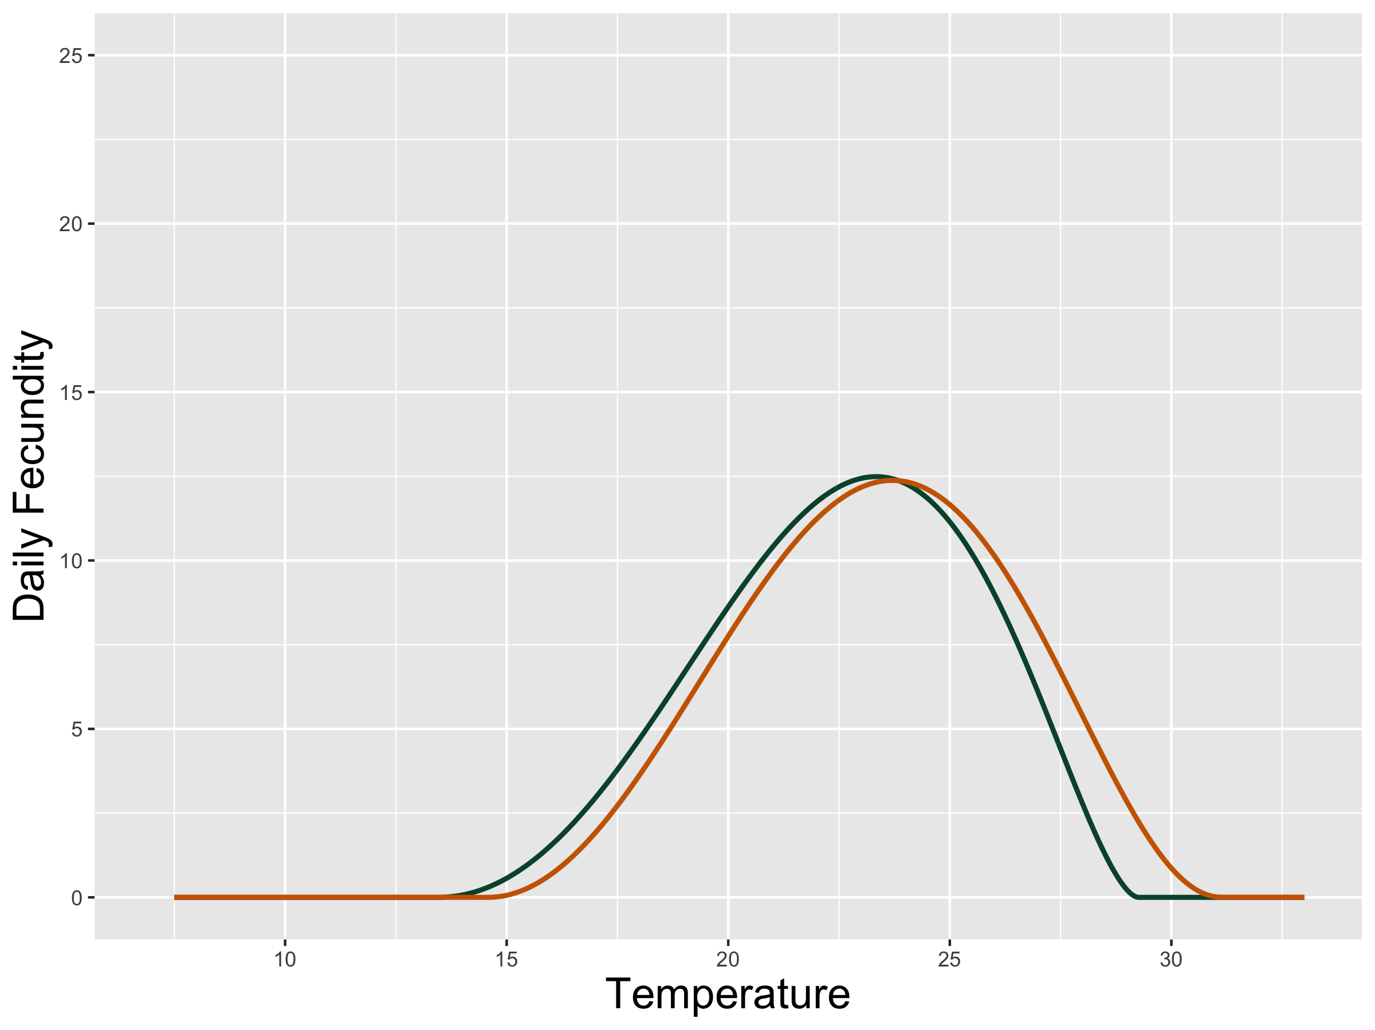
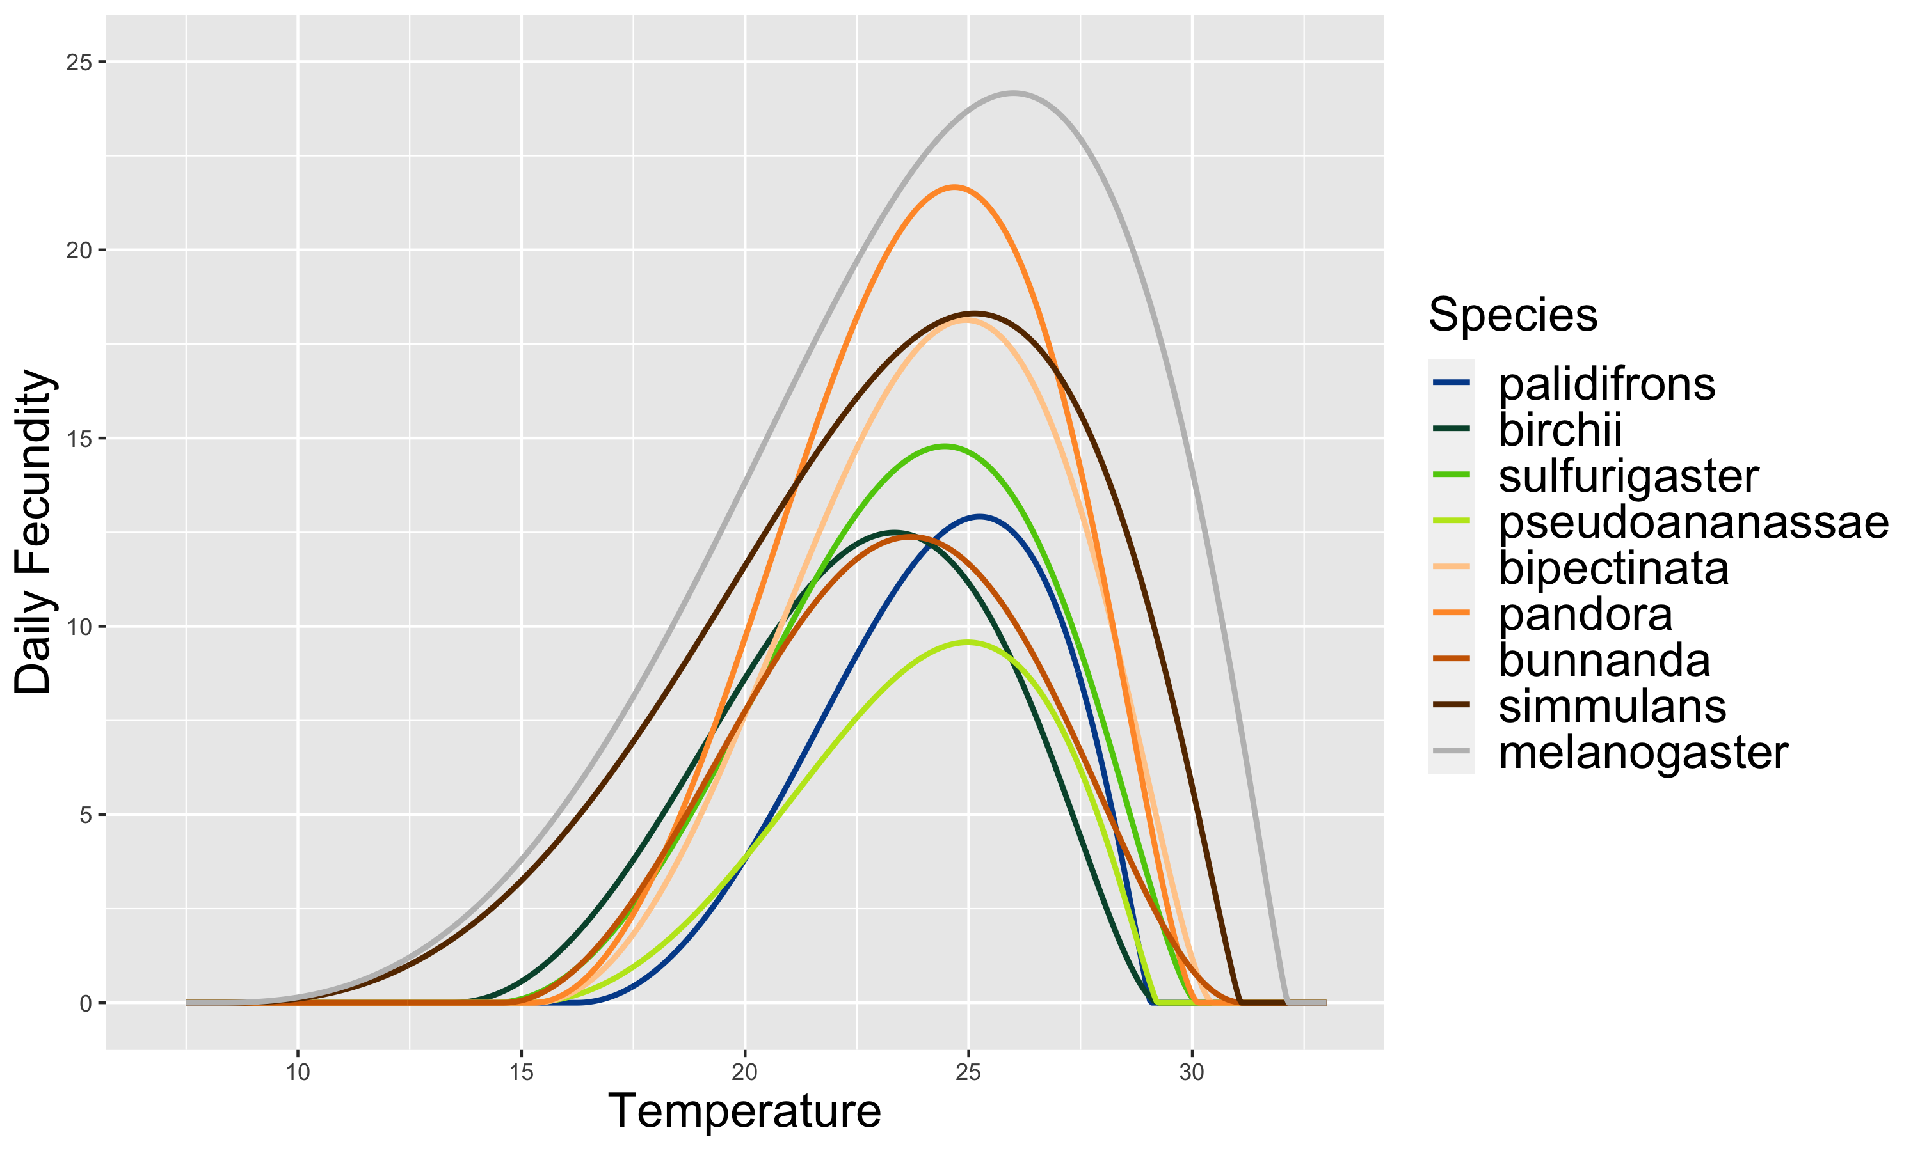
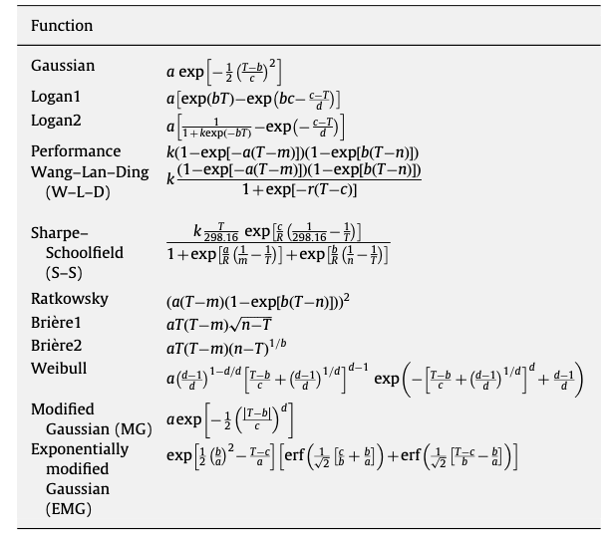
Thermal performance (reproduction) curves
(Early life)
RT.max
RT.min
(Fitted using hierarchical
Bayesian method by rstan)

Slide 10
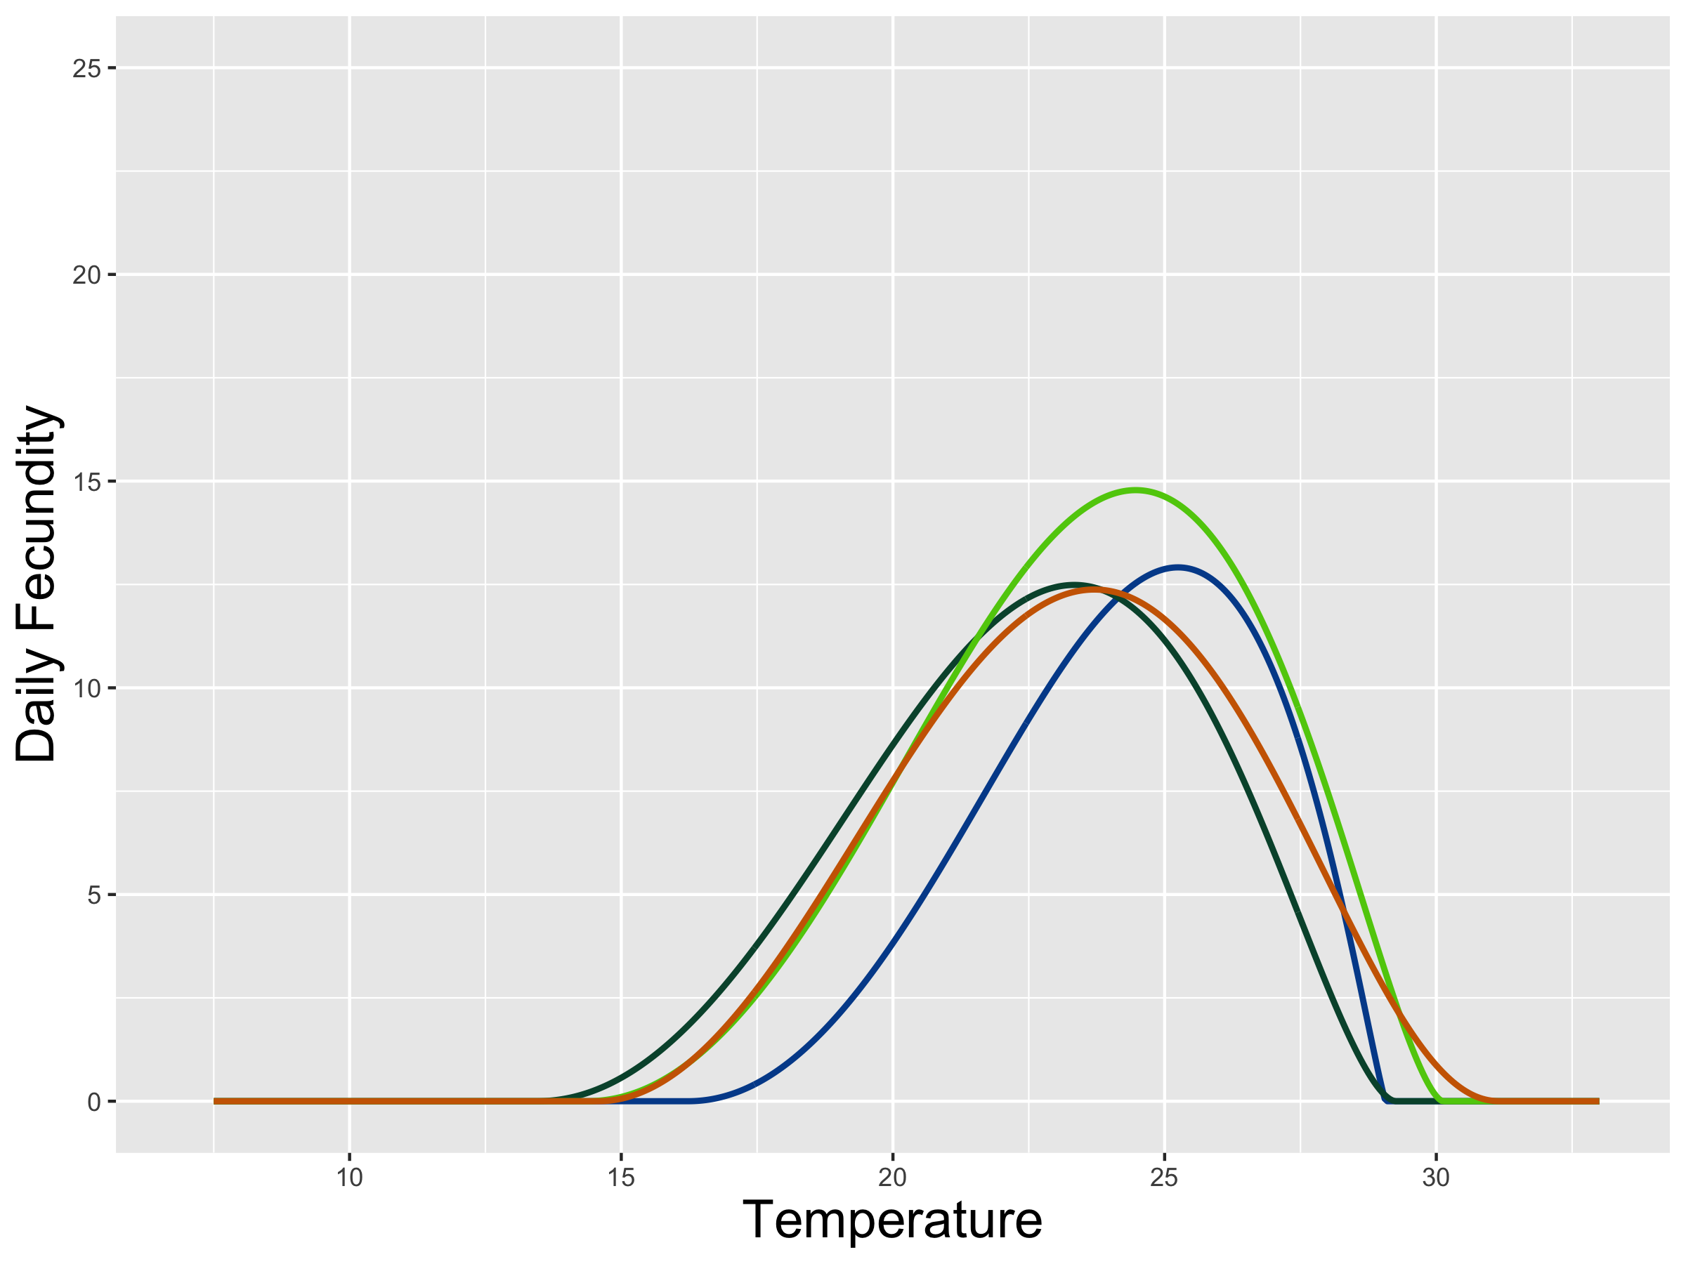
Thermal performance (reproduction) curves
(Early life)
(Fitted using hierarchical
Bayesian method by rstan)

Slide 11
Thermal performance (reproduction) curves
(Early life)
(Fitted using hierarchical
Bayesian method by rstan)

Slide 12
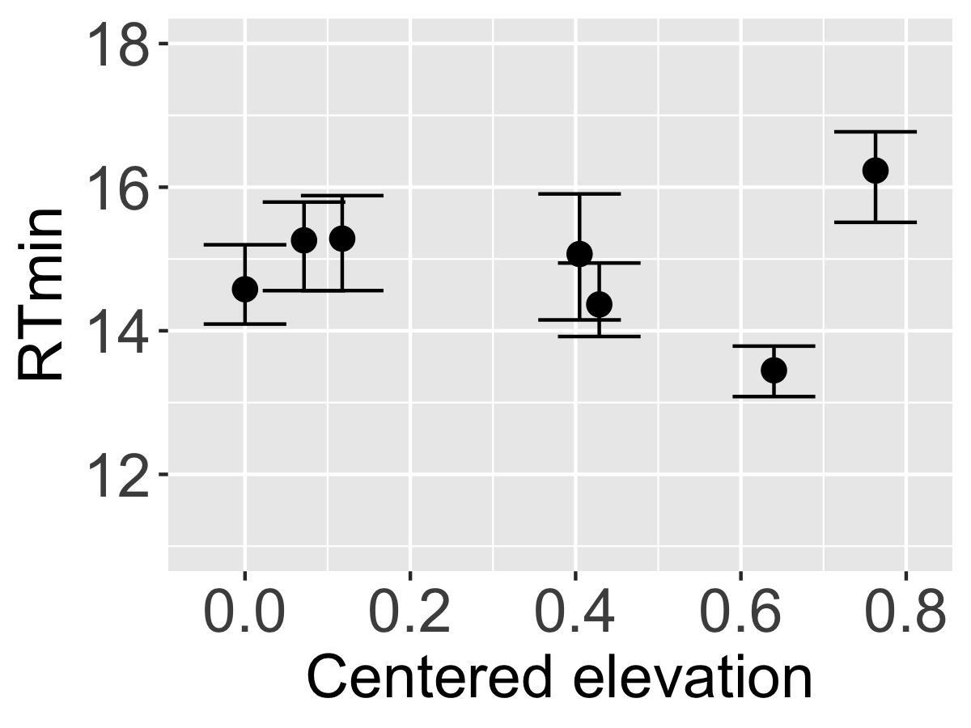
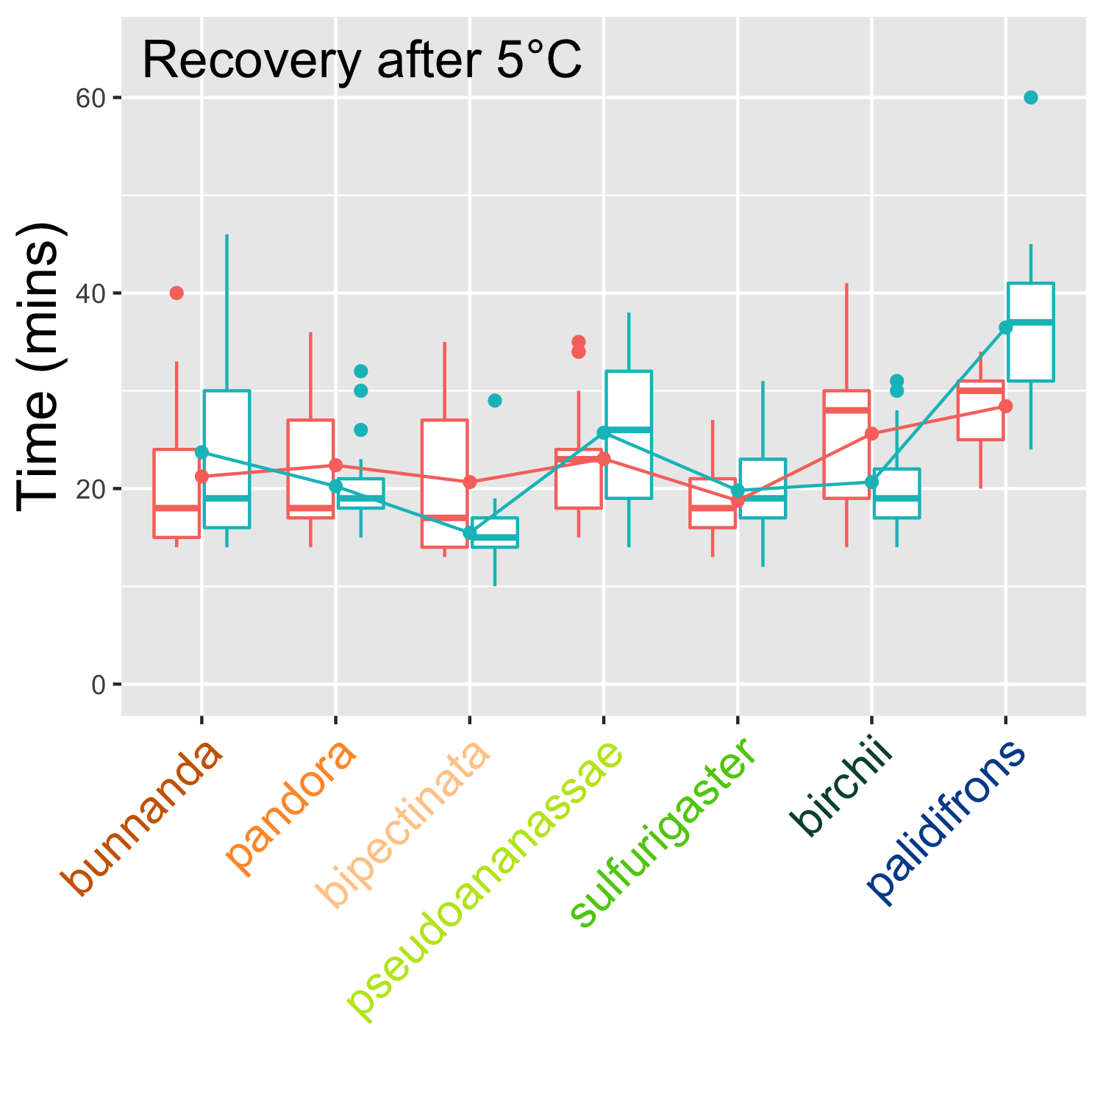
NO
Are upland-biased species more cold-tolerant?
0.024 (P = 0.56)
no phylogenetic signal
male: 14.7 (P = 0.054)
female: 7.9 (P = 0.029)
Fecundity at 17°C | -0.27 | 0.788
Recovery after 14°C | 0.054 | 0.105

Slide 13
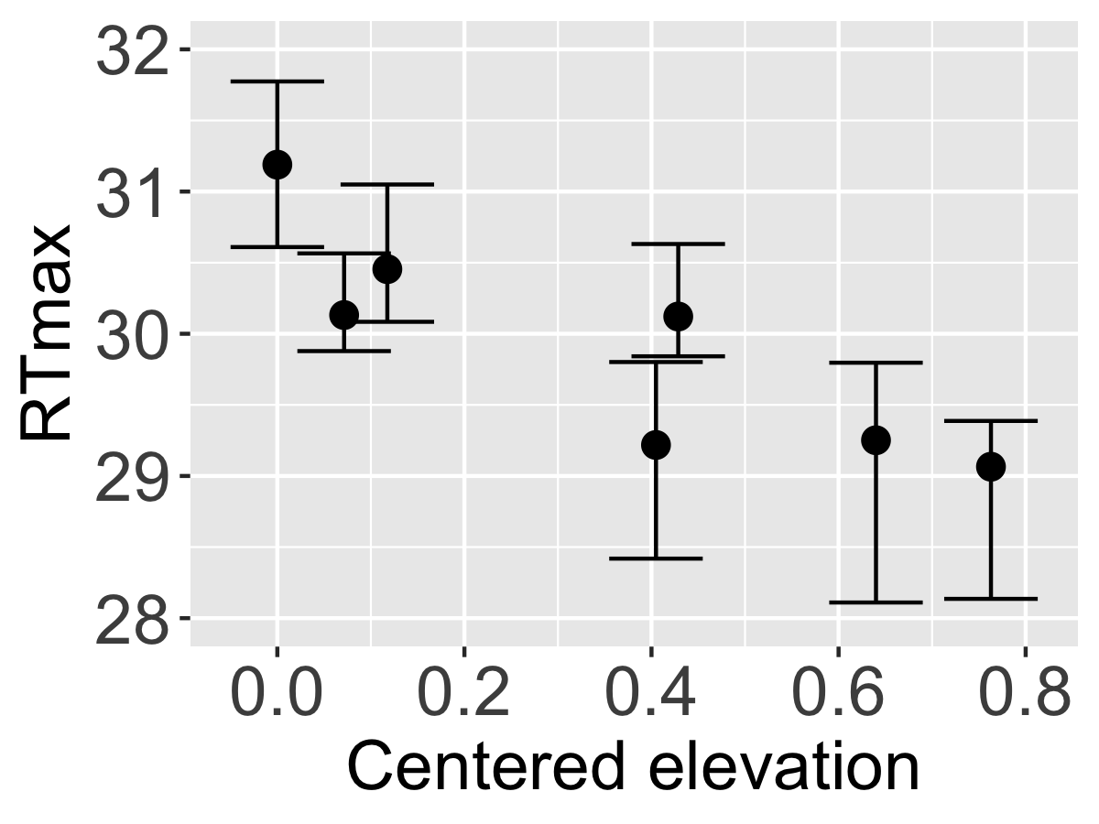
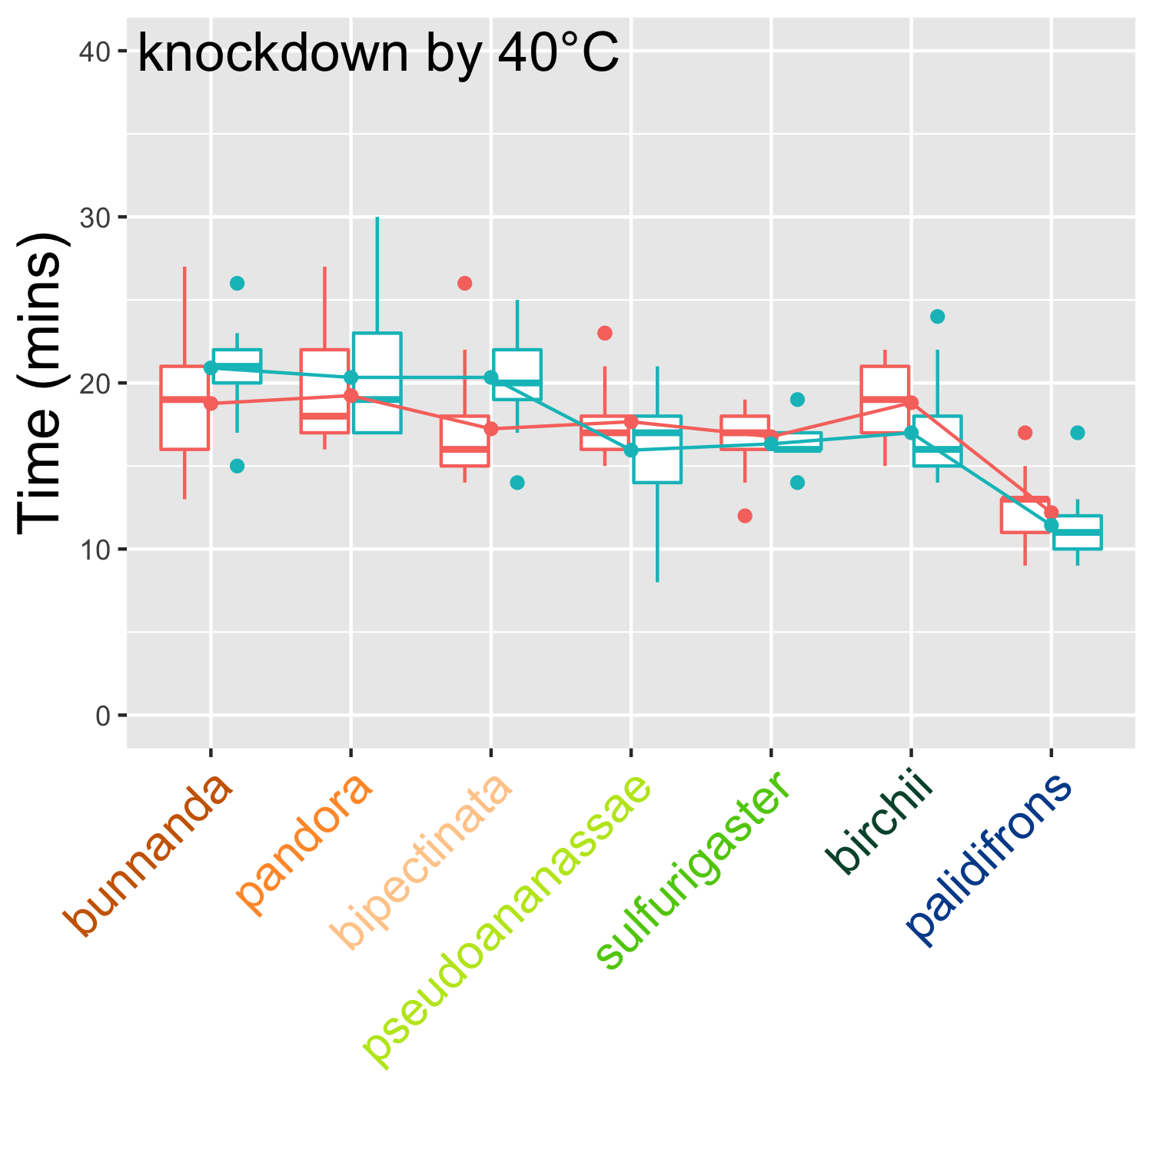
Yes
Are lowland-biased species more heat-tolerant?
coef. = -2.5 (P = 0.0013)
no phylogenetic signal
male: -9.1 (P = 0.001)
female: -5.4 (P = 0.056)
Fecundity at 29C | -5.09 | P <0.0001
Recovery after 29C | -7.1 | P = 0.13

Slide 14
1) Upland environment is a non-stressful environment to all species
2) Lowland species are outcompeted by upland species
From Thermal Traits to Distribution
3) Upland species are constrained by heat when moving downward
4) Low performance of upland species give space and resource to support more lowland species

Slide 15
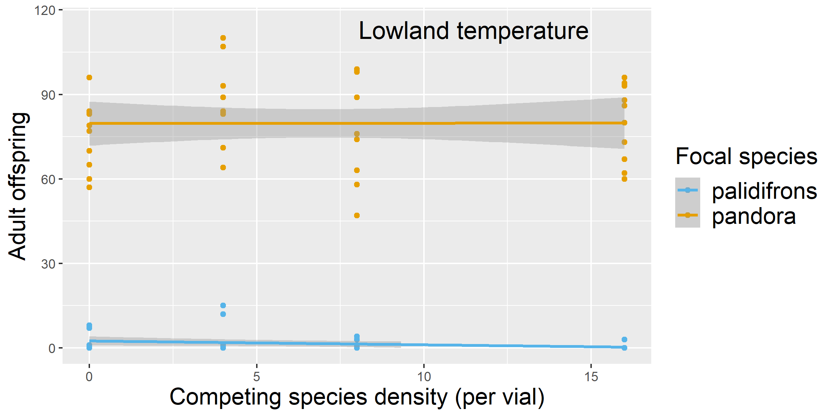
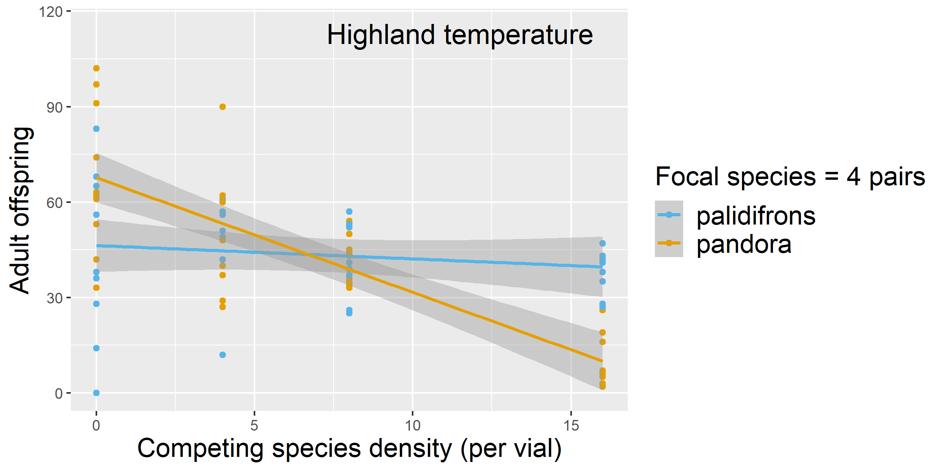


Competition along the temperature gradient
(Competition set-up)
Inferred long-term outcome
by modern coexistence theory
D.Palidifrons will die out by itself
D.pandora will persist
D.palidifrons will persist
D.pandora will be competitively excluded

Slide 16

Conclusions
Thermal traits varies among tropical species (e.g. upper limits, lower limits).
Temperature and competition have asymmetrical roles in determining abundance along elevations.
Some tropical Drosophila species are already constrained by daily high temperature in tropical lowlands, implying the vulnerability of this system to future warming.
Photo credit: Ash

Slide 17




Acknowledgements
(Owen Lewis, Chris Terry, Mark Wong, Jamal Holle, etc.)
Oxford Zoology Fly Lab
(Eleanor Bath, Irem Sepil, Jen Perry, Stuart Wigby, Dani Edmunds, etc.)
(Jan Hrcek, Chia-Hua Lue, Mélanie Thierry, Anna Jandová, etc.)

Slide 18
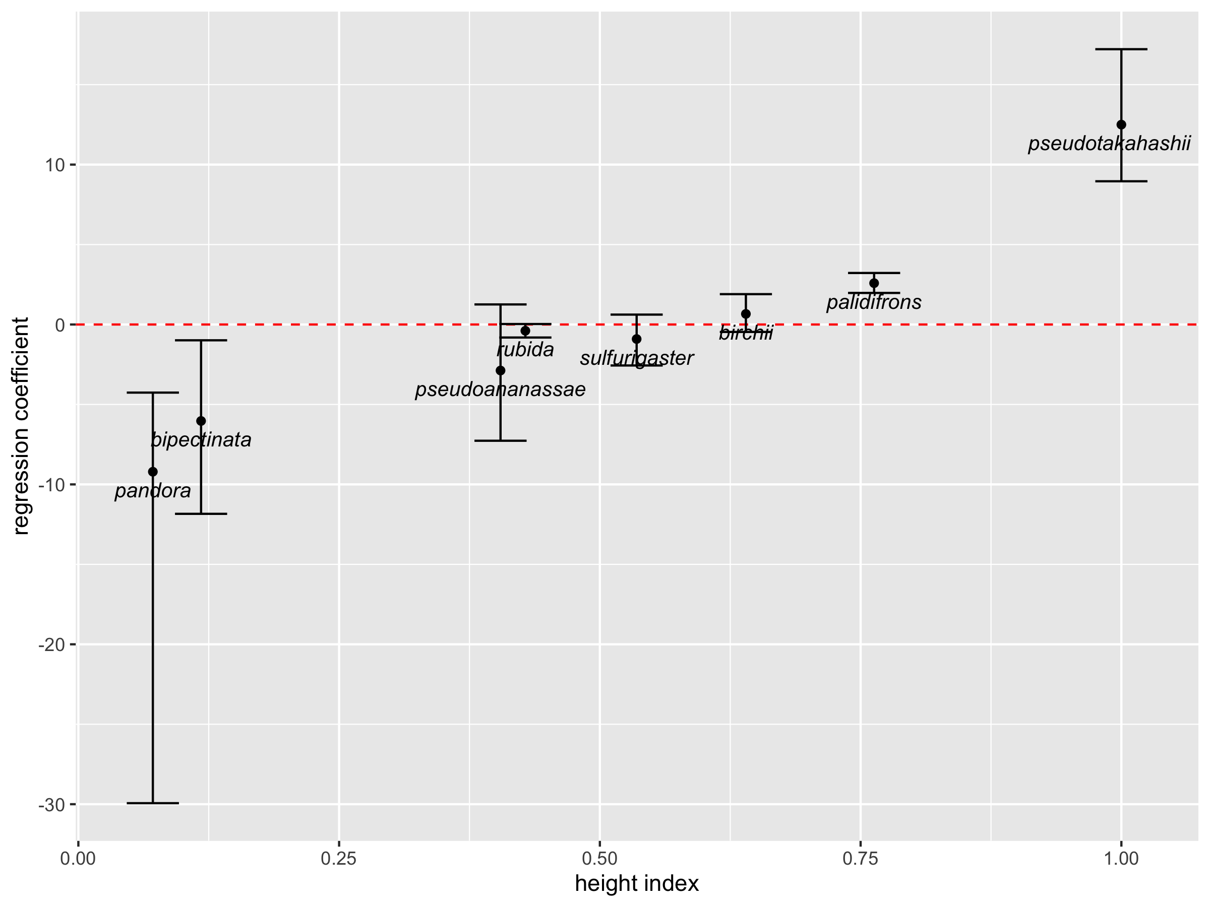
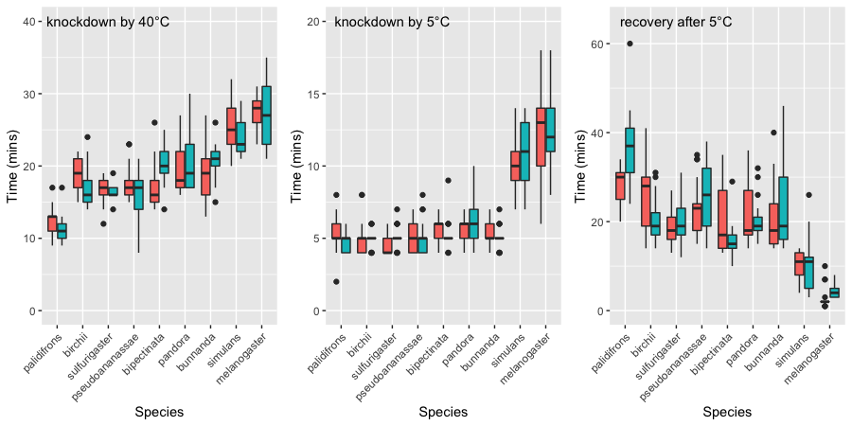
Linear regression (7 species) | Correlation analysis
X | Y | Coef. | P value
RTmin | altitude index | 0.024 | 0.56
Fecundity at 17C | altitude index | -0.27 | 0.788
Recovered fecundity after 14C | altitude index | 0.054 | 0.105
Knockdown time at 5C | altitude index | -0.8 -0.3 | 0.18 (M) 0.53 (F)
Recovery time after 5C | altitude index | 14.7 7.9 | 0.054 (M) 0.029 (F)
Spearman’s rank test
Rho = 0.98
P < 0.001
RTmin | CI_RTmin | RTmax | CI_RTmax
16.23 | 15.51 - 16.77 | 29.07 | 28.14 - 29.39
13.45 | 13.08 - 13.79 | 29.25 | 28.11 - 29.80
14.37 | 13.92 - 14.94 | 30.12 | 29.84 - 30.63
15.07 | 14.15 - 15.91 | 29.22 | 28.42 - 29.80
15.28 | 14.56 - 15.88 | 30.45 | 30.08 - 31.05
15.26 | 14.56 - 15.79 | 30.13 | 29.88 - 30.57
14.58 | 14.09 - 15.20 | 31.19 | 30.61 - 31.77
8.51 | 6.94 - 9.66 | 31.08 | 30.38 - 31.78
8.32 | 6.93 - 9.38 | 32.13 | 32.03 - 32.28
Linear regression (7 species) | Correlation analysis
X | Y | Coef. | P value
RTmax | altitude index | -2.52 | 0.0013
Fecundity at 29C | altitude index | -5.09 | <0.0001
Recovered fecundity after 29C | altitude index | 4.44 | 0.14
Knockdown time at 40C | altitude index | -9.1 -5.4 | 0.0013 (M) 0.056 (F)
Notes:
hide

Slide 19
NO
Are upland-biased species more cold-tolerant?
0.024 (P = 0.56)
no phylogenetic signal
male: 14.7 (P = 0.054)
female: 7.9 (P = 0.029)
Fecundity at 17°C | -0.27 | 0.788
Recovery after 14°C | 0.054 | 0.105

Slide 20
Yes
Are lowland-biased species more heat-tolerant?
coef. = -2.5 (P = 0.0013)
no phylogenetic signal
male: -9.1 (P = 0.001)
female: -5.4 (P = 0.056)
Fecundity at 29C | -5.09 | P <0.0001
Recovery after 29C | -7.1 | P = 0.13

Slide 21
1) Upland environment is a non-stressful environment to all species
2) Lowland species are outcompeted by upland species
From Thermal Traits to Distribution
3) Upland species are constrained by heat when moving downward
4) Low performance of upland species give space and resource to support more lowland species

Slide 22
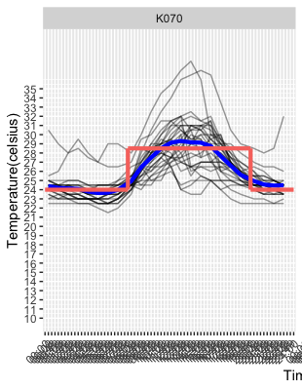
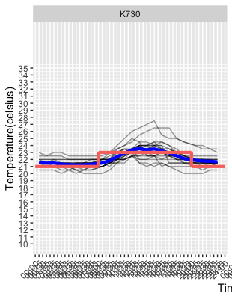
(Competition set-up)

Slide 23
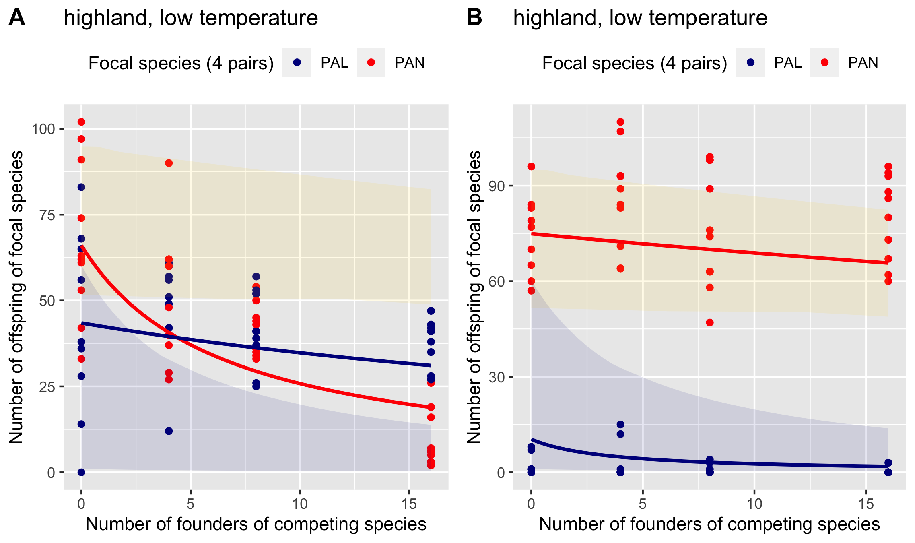
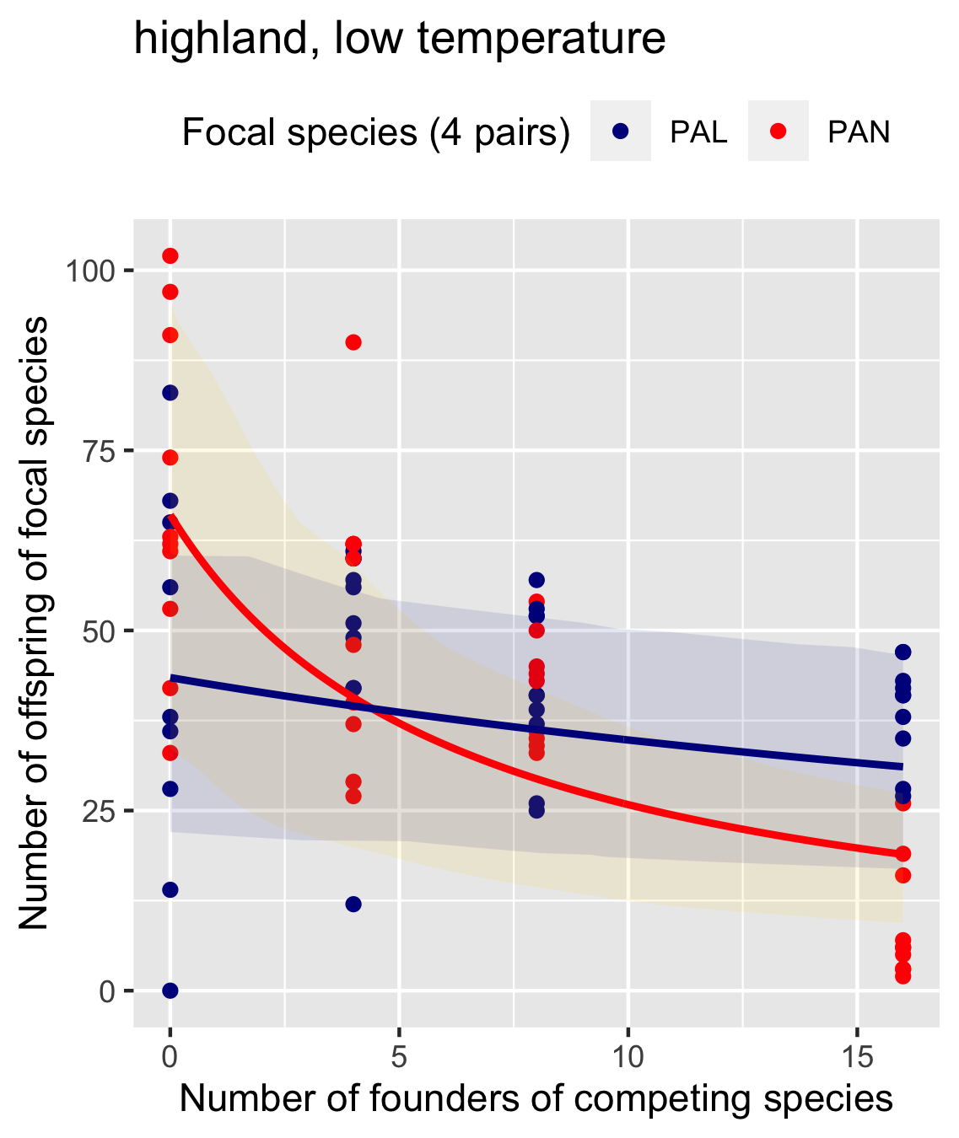
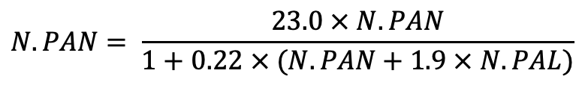
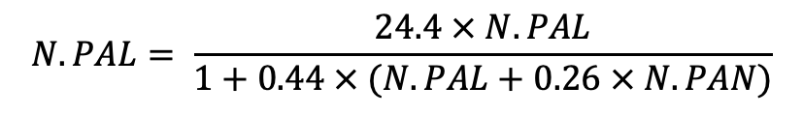
$$N.PAN= \frac{23.0 × N.PAN}{1+0.22 × (N.PAN+1.9 × N.PAL)}$$
Upland-lowland pair
$$N.PAL= \frac{24.4 × N.PAL}{1+0.44 × (N.PAL+0.26 × N.PAN)}$$

Slide 24
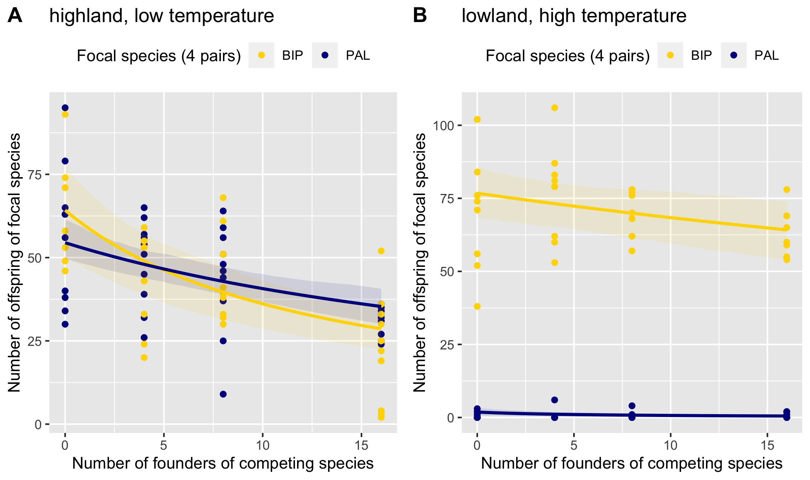
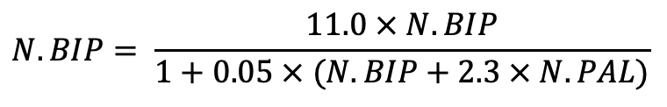
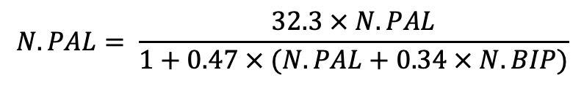
$$N.BIP= \frac{11.0 × N.BIP}{1+0.05 × (N.BIP+2.3 × N.PAL)}$$
Upland-lowland pair
$$N.PAL= \frac{32.3 × N.PAL}{1+0.47 × (N.PAL+0.34 × N.BIP)}$$

Slide 25
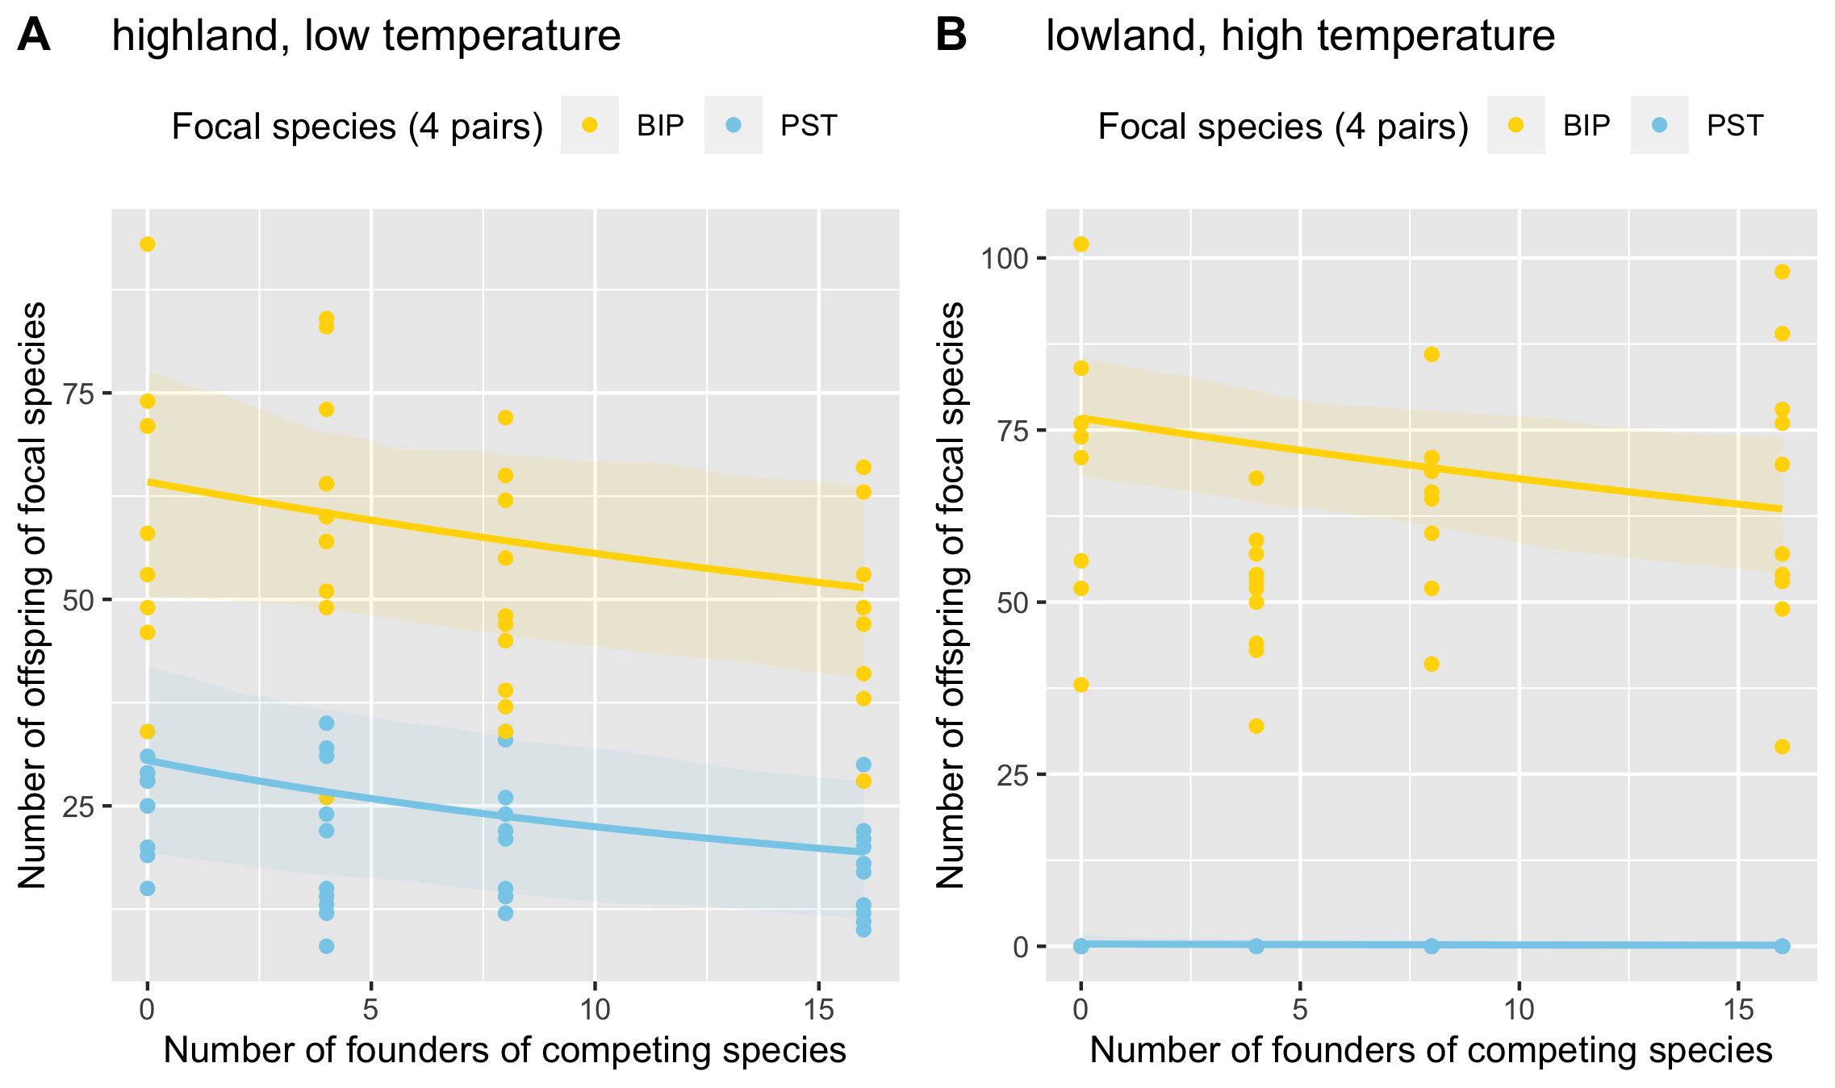
Upland-lowland pair

Slide 26
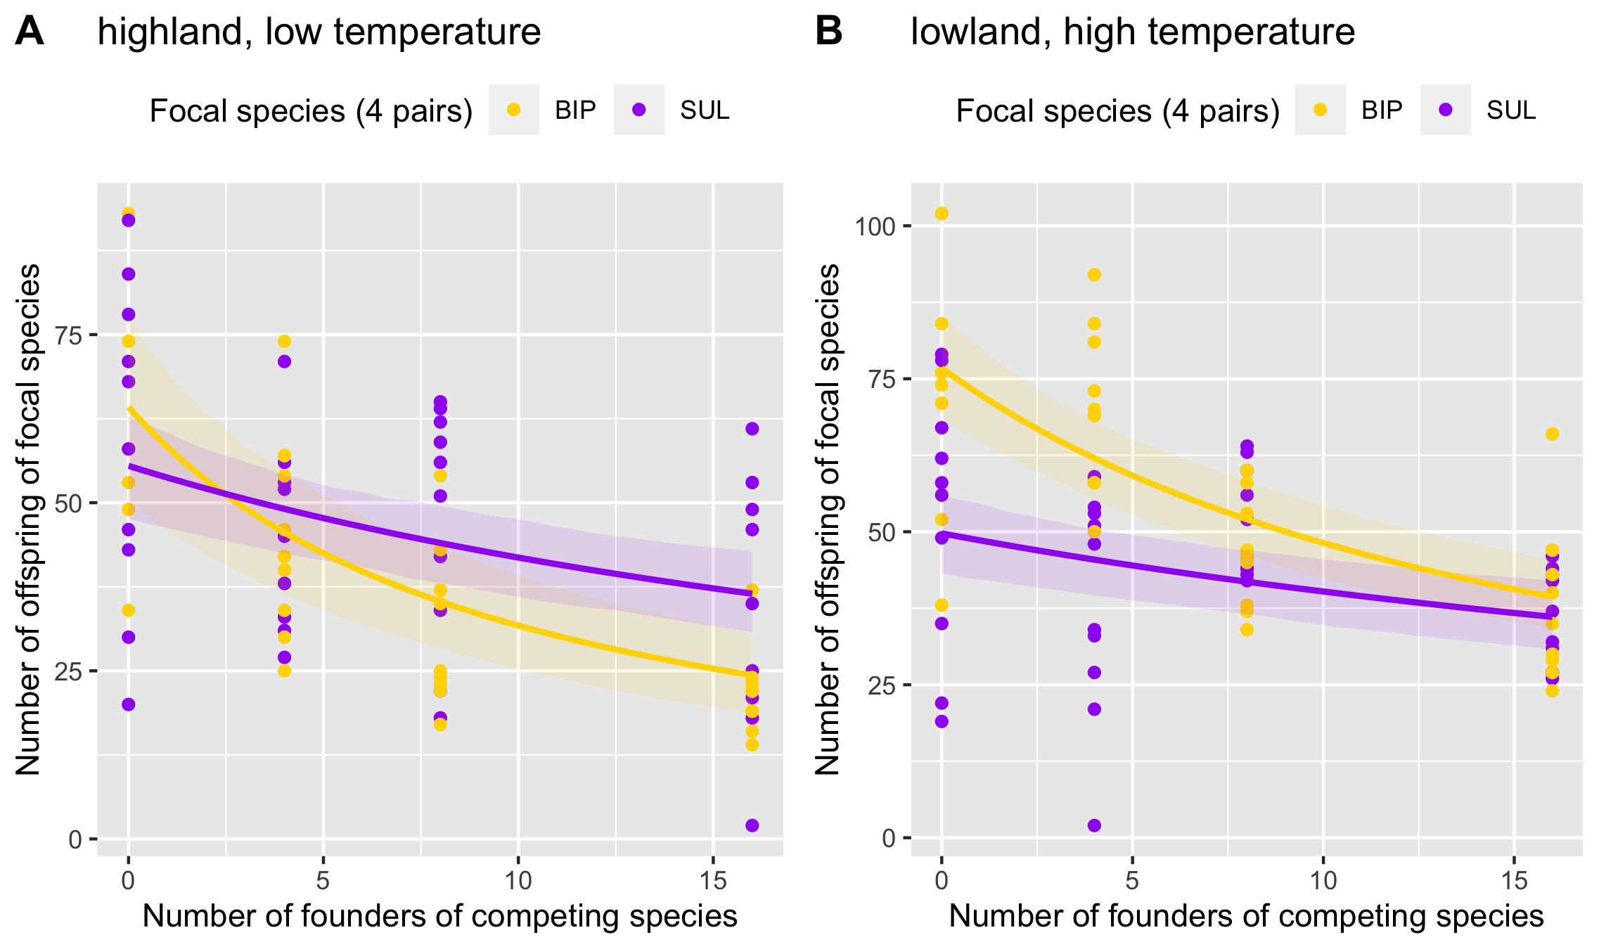
Widespread-lowland pair

Slide 27
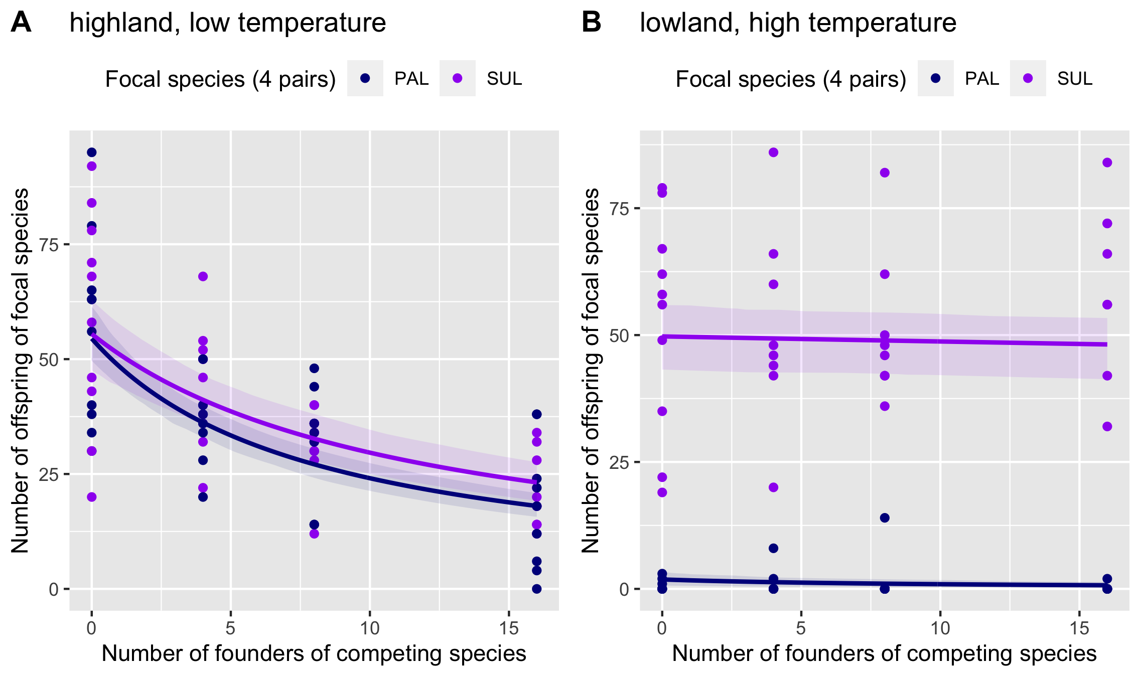
Widespread-upland pair

Slide 28
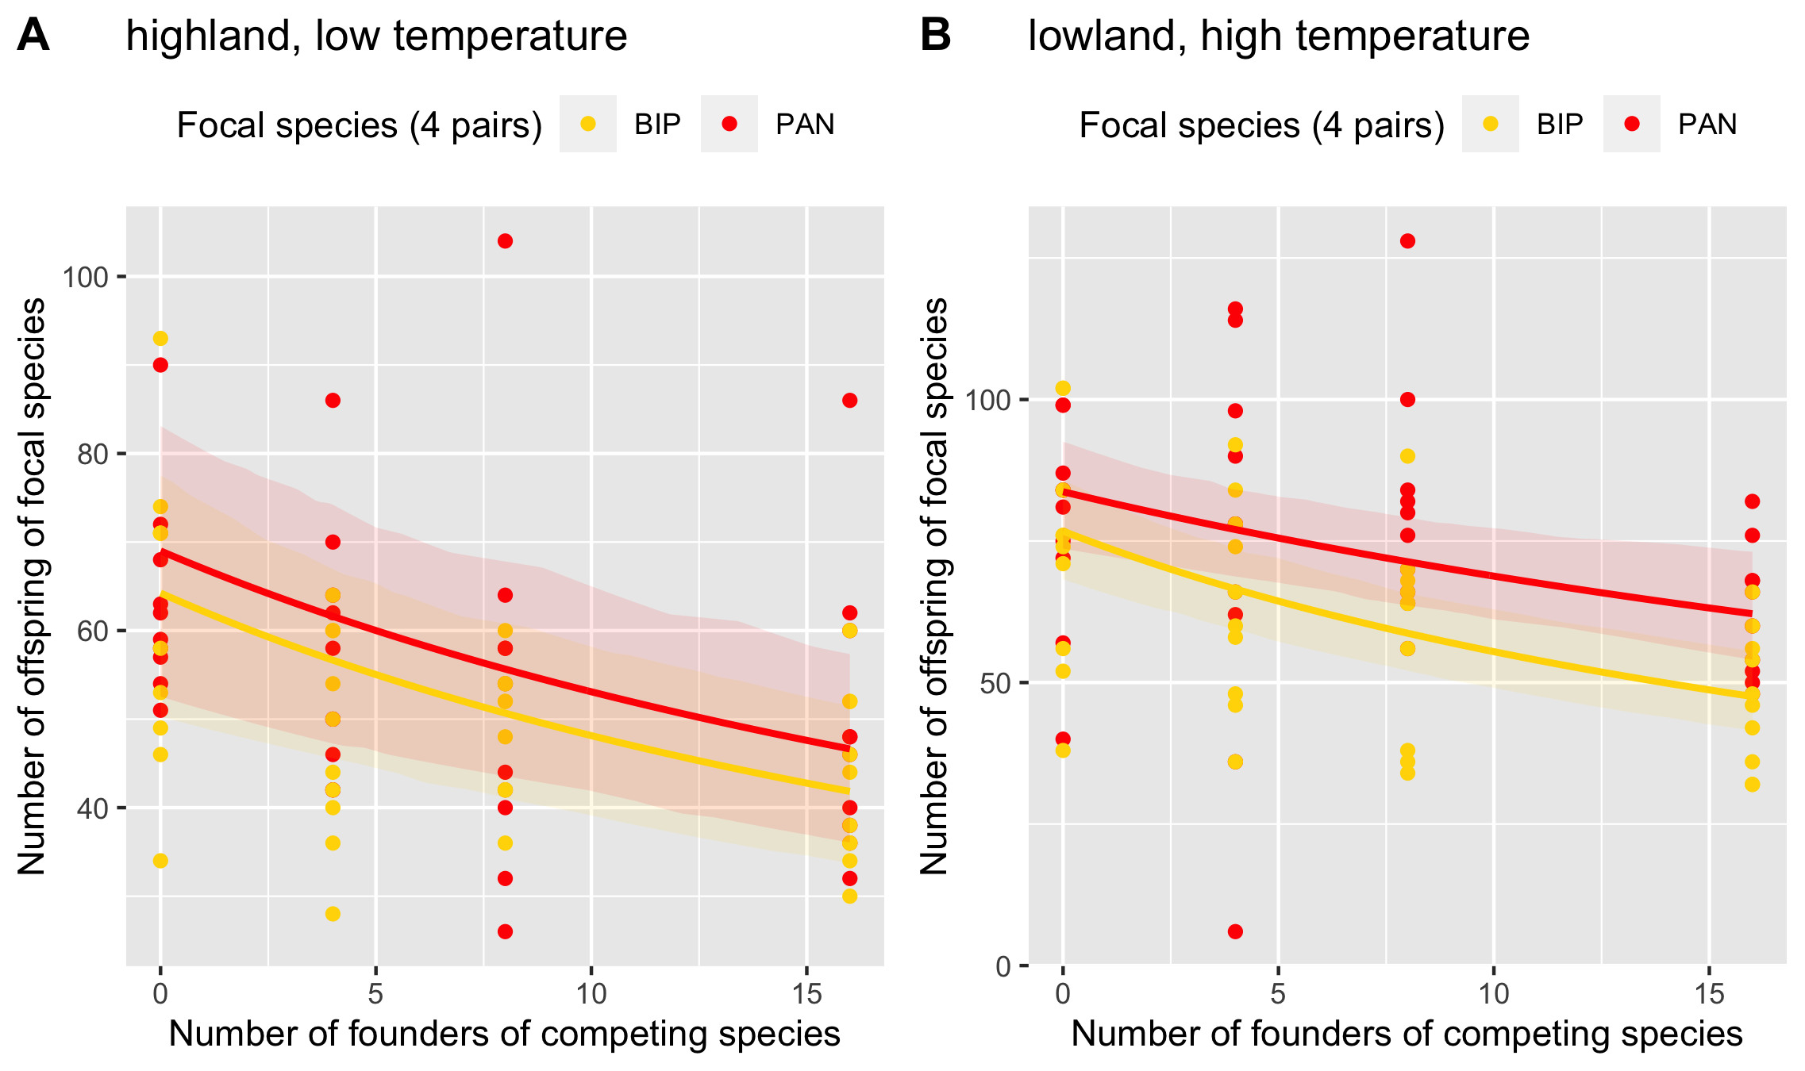
lowland-lowland pair
lowland-lowland pair

Slide 29
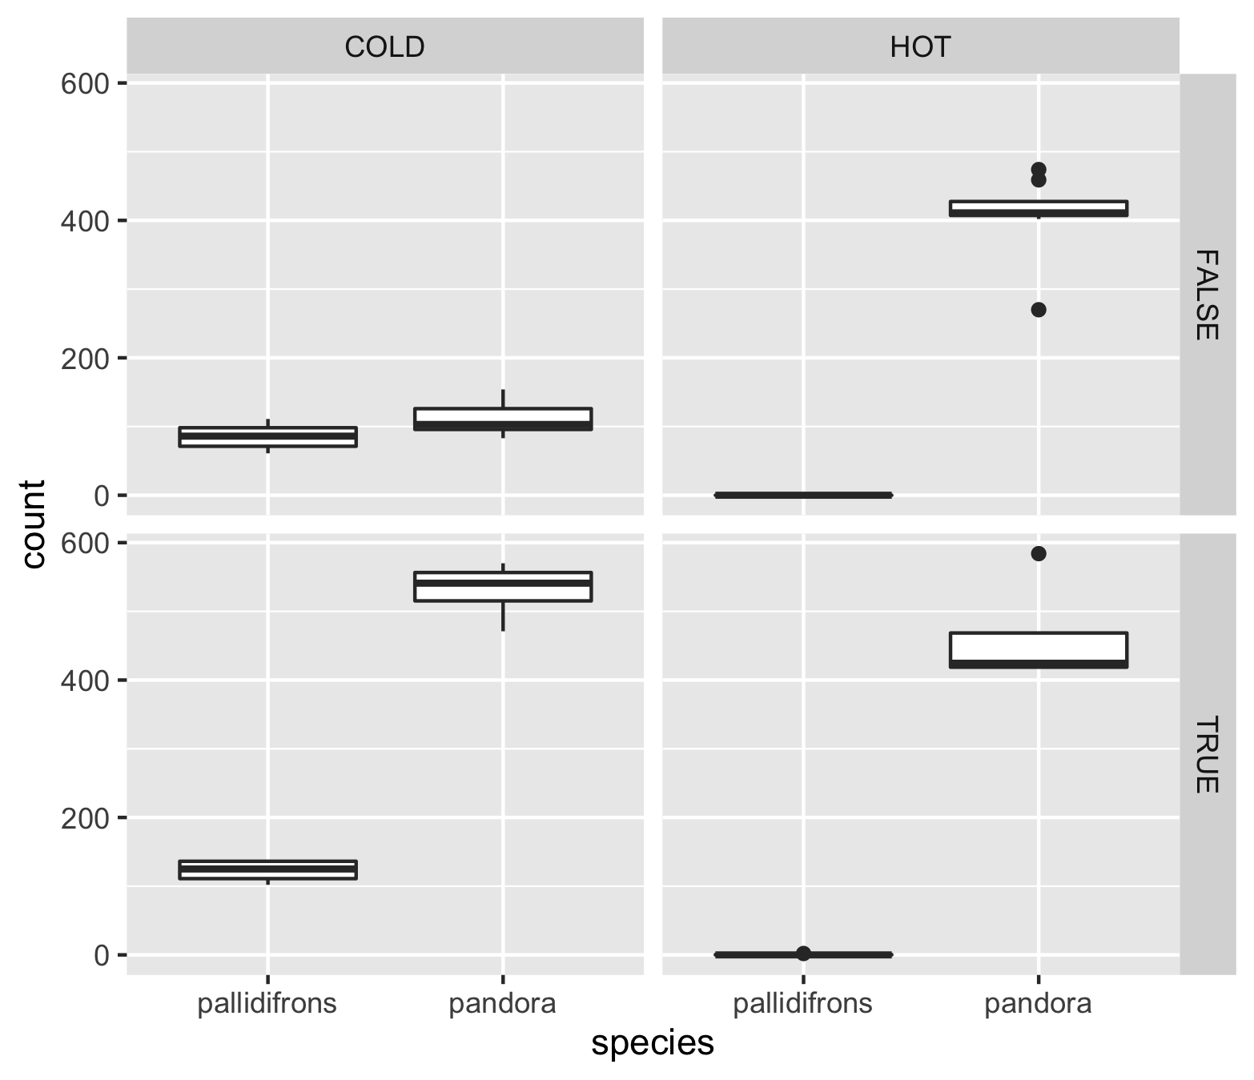
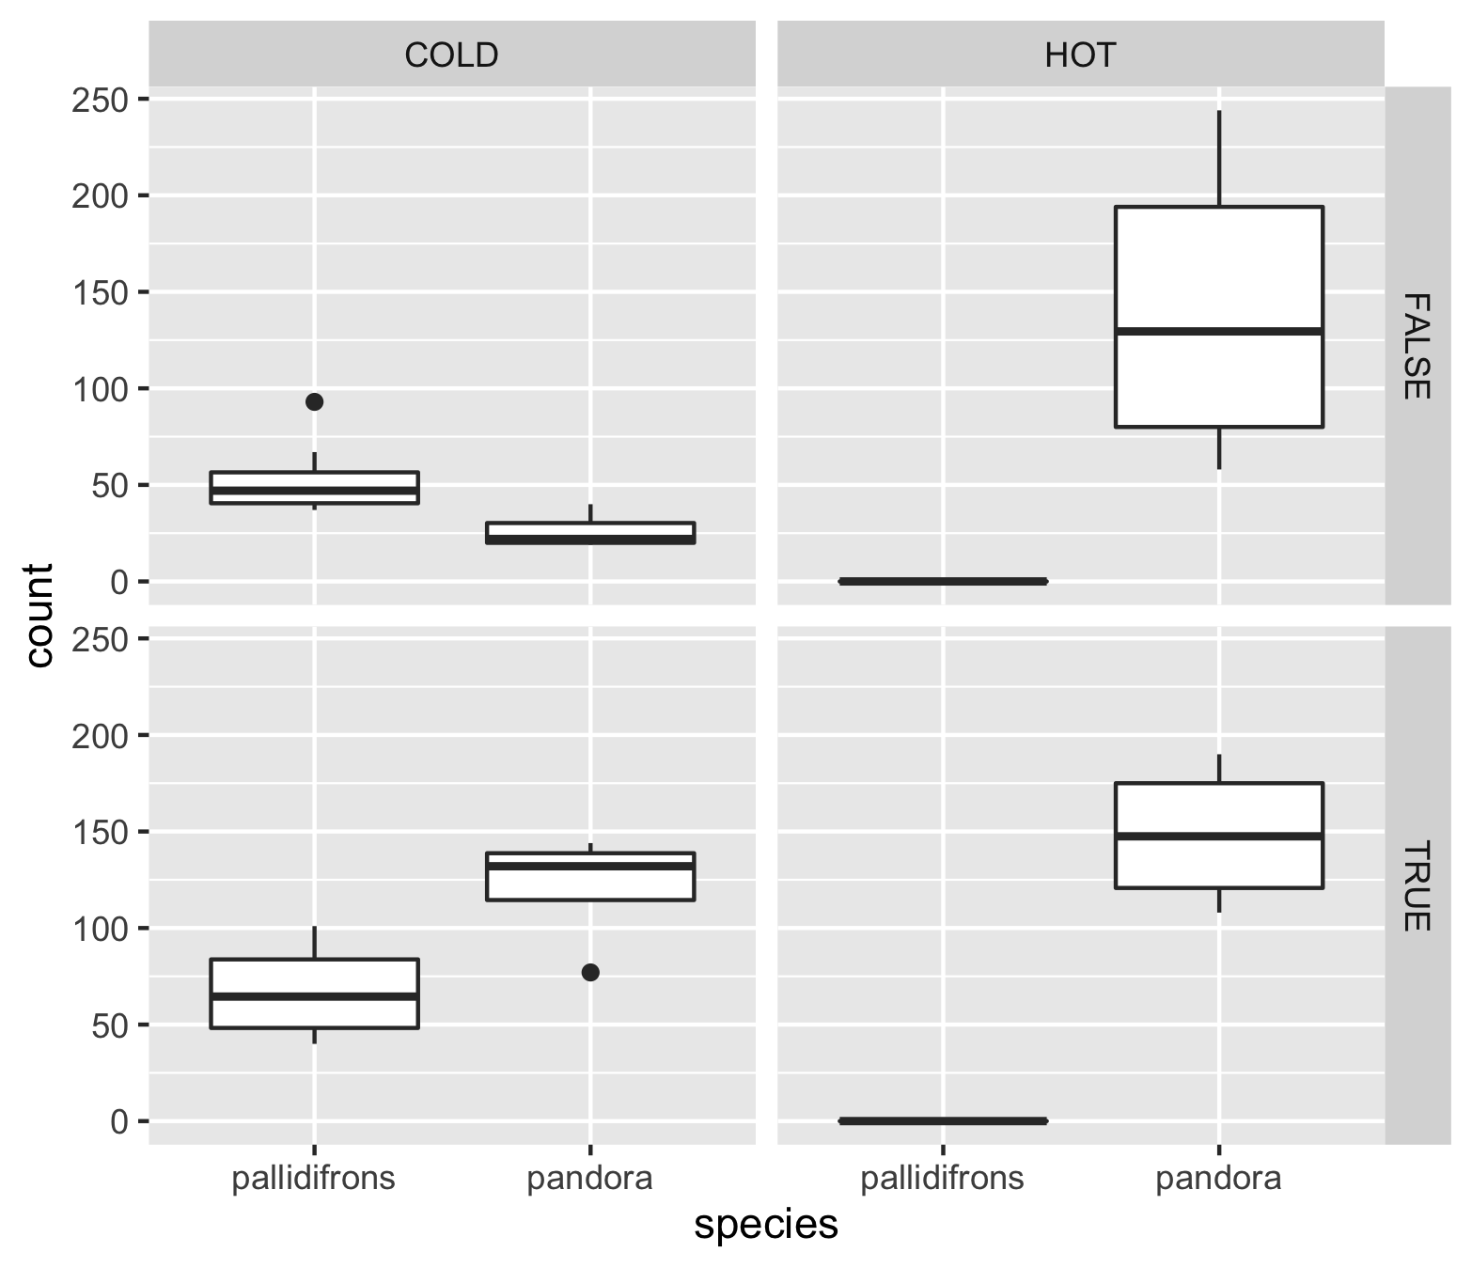
long-term (13 weeks) competition outcome
lowland-lowland pair
Survived from last transfer
Newly emerged adults
Mixed species bottles
Single species
bottles

Slide 30
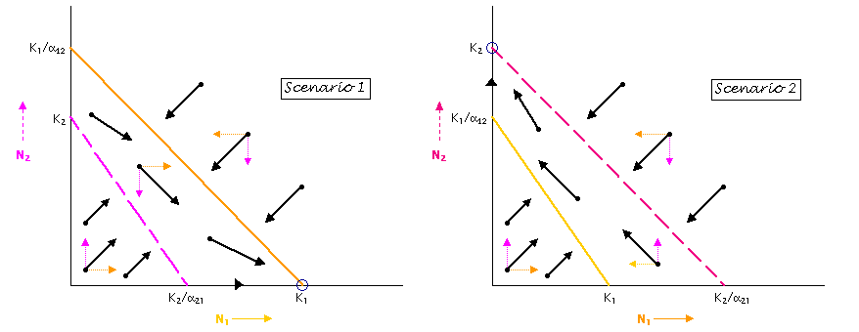
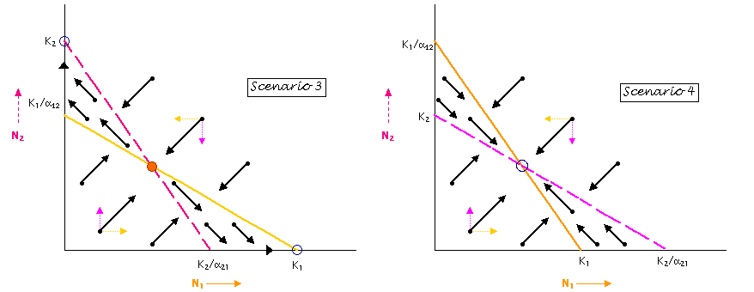
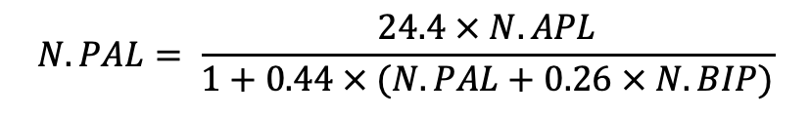
$$N.PAN= \frac{23.0 × N.PAN}{1+0.22 × (N.PAN+1.9 × N.PAL)}$$
Inference of coexistence?
$$N.PAL= \frac{24.4 × N.APL}{1+0.44 × (N.PAL+0.26 × N.BIP)}$$

